Slide 1


IWPAIB
"I want Pizza and I'm broke"

Slide 2
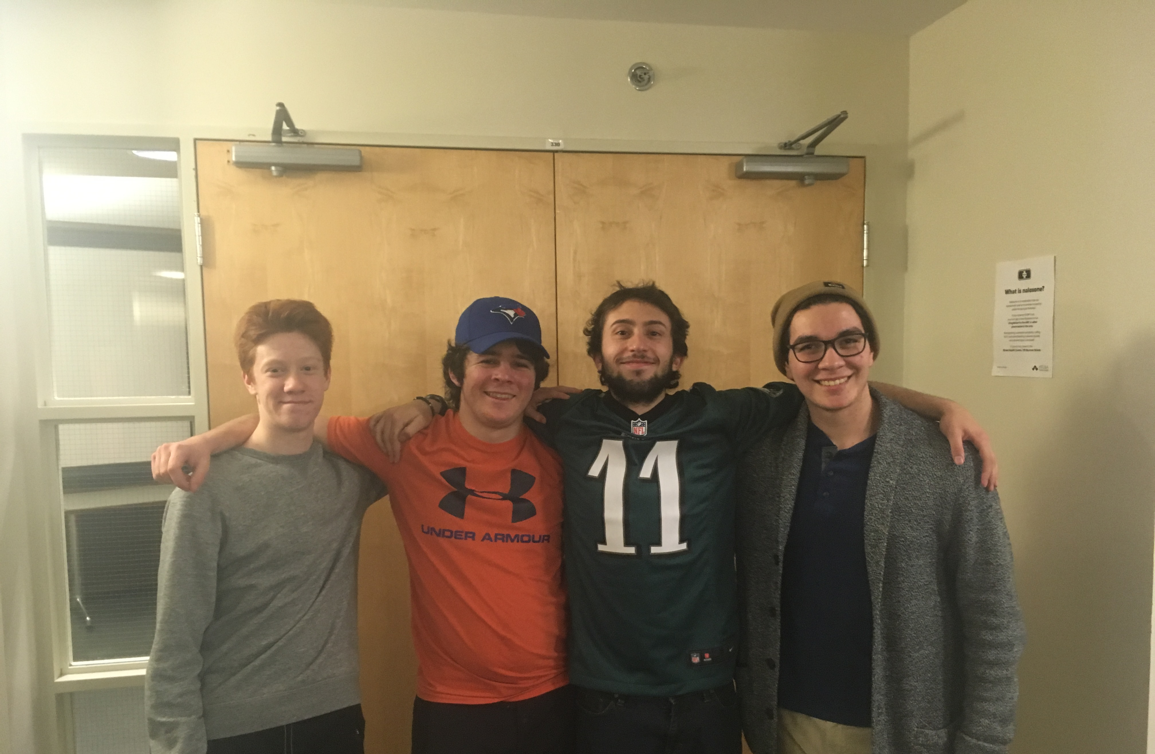
Members
From Left to Right
James, Mathew, Armando, Bastiaan

Slide 3
Task
Make a web service that finds the cheapest pizza within a radius of a given address entered by the user. In addition, it MUST be a web scrapping application.

Slide 4
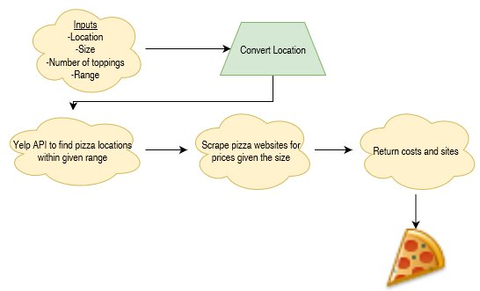

Slide 5

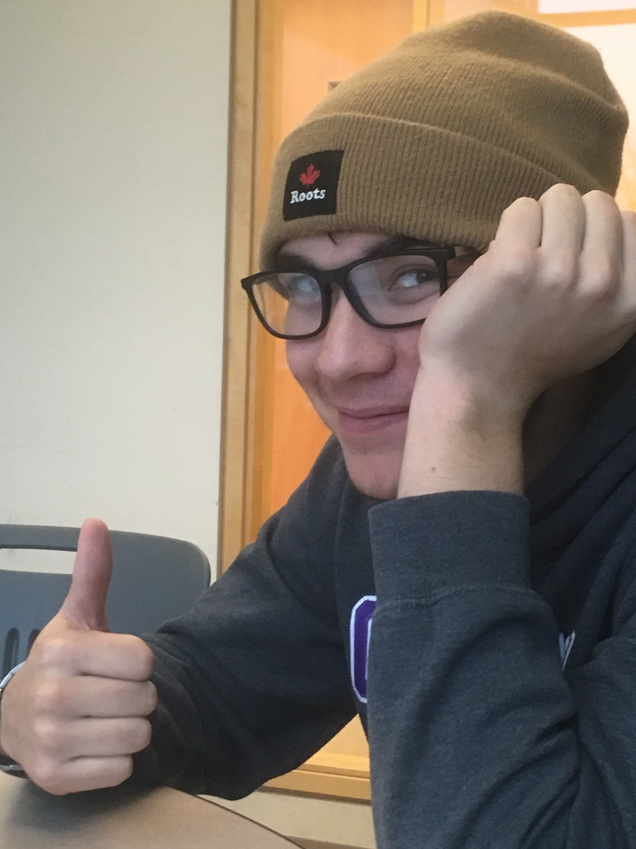
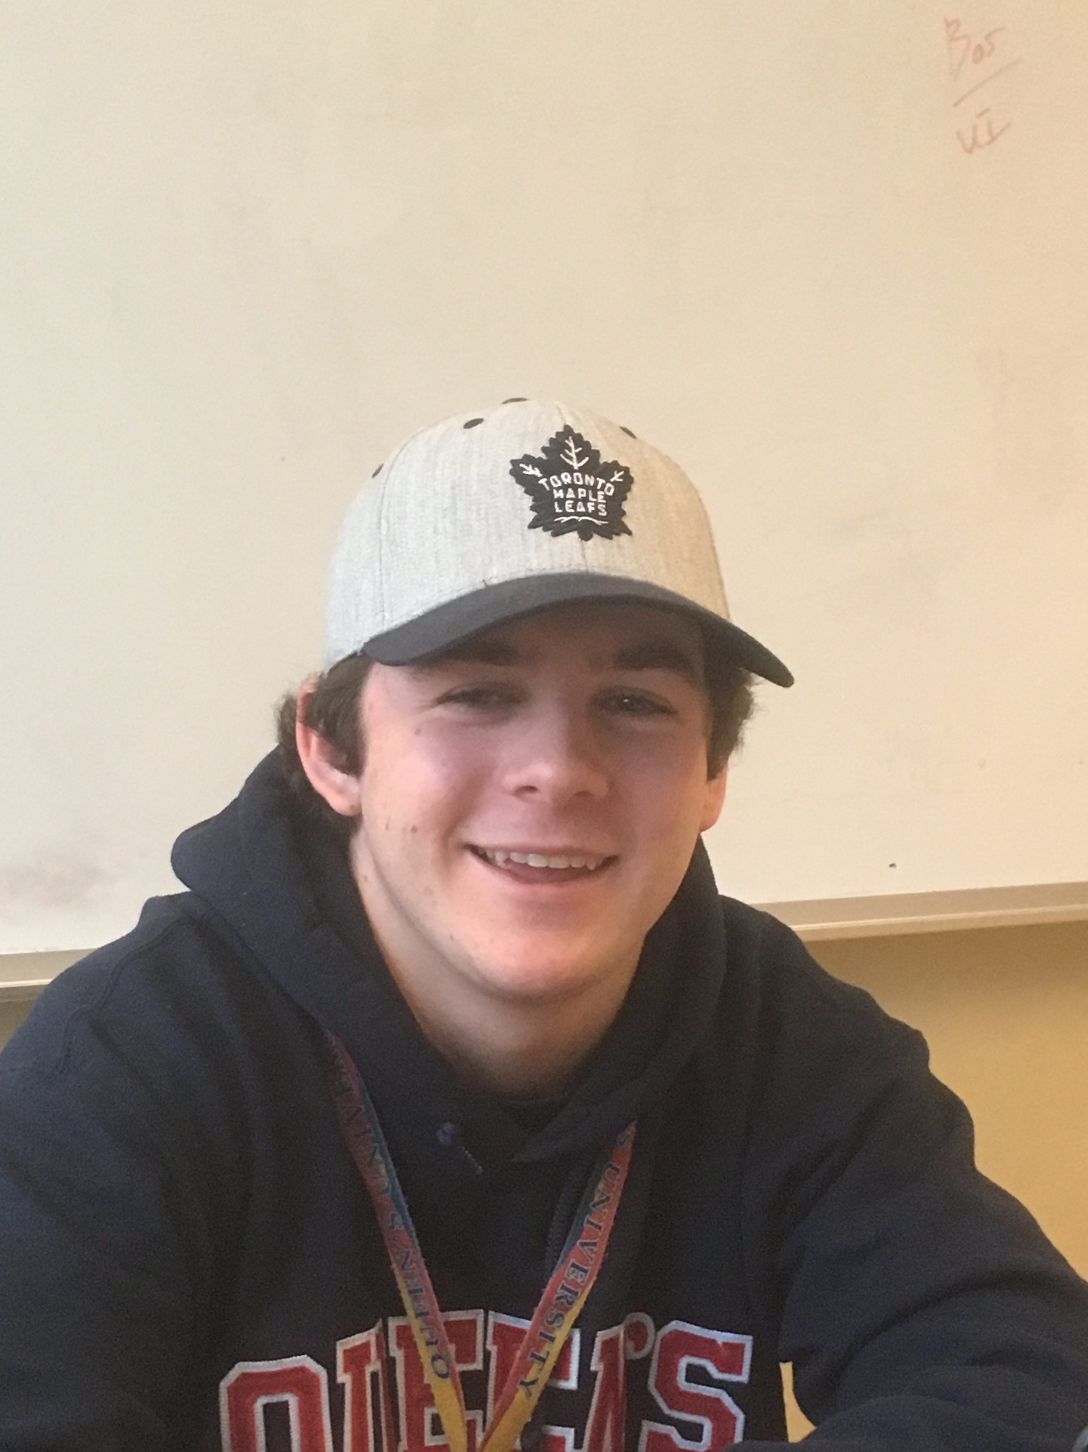
Thank you for listening!!!

